Slide 1
VERSATILE AND REAL-TIME IOT BASED HEALTH MONITORING SYSTEM AND IDENTIFYING AILMENTS OF THE SKIN SDG[3] :Good Health And Well-being
TEAM MEMBERS:
DEEPASREE M (211420104055)
DEEPIKA P (211420104056)
INDHUMATHI V (211420104100)
GUIDE : Ms.V.SATHIYA (ASSOCIATE PROFESSOR)
Batch no.: A4

Slide 2
ABSTRACT
The Internet of Things (IoT)-based health monitor is designed to make sick and tired people's mobility and strain easier. It describes a vast global network of physical objects that are connected to the internet. The objects are implanted with sensors, actuators, and connectivity, which allows them to gather, share, and use data.
As they can analyze data and employ AI to carry out specified tasks, these gadgets are frequently referred to as "smart devices". Currently, in order to receive outputs, A real-time health monitoring system enables patients to expeditiously finish all required medical testing in one place. Unlike previous research, this study was innovative in that all of the testing devices were used together.
The majority of patients would prefer to use these kinds of devices for diagnosis, according to the survey. Multiple devices ( blood pressure, heart sensor, metal sensor, alcohol sensor, GSM) are combined to form a single device. After each circuit is actually put into practice using a variety of sensors and the Arduino platform. Its main objective is also to obtain all of the test data from the server. All of the test results were transferred from the main device to the web server and skin illness prediction was carried out, and the result is viewed simultaneously.
An application is built which is used to predict skin disorders using machine learning, analyze the skin diseases, and report on them. After the primary device was put into use and measured, the results obtained were deemed to be fairly satisfactory. After the system's efficacy was investigated, several cost- effective and human health-safe results were reached. In light of the results of the final survey, which aims to collect feedback from device users, some conclusions might be suggested.

Slide 3
INTRODUCTION
Convenience and accessibility for users will be prioritized in the design of the Arduino-based health monitoring system. Because of its small size and portability, users will be able to easily incorporate it Wireless connectivity options will be included in the system, allowing data to be transmitted through sensors for easy tracking and analysis.
Using image processing techniques, the skin ailment identification module will be able to precisely diagnose a variety of dermatological illnesses, ranging from common problems like eczema and acne to more serious ones like melanoma. Early detection capabilities enable users to take preventative action and swiftly address skin concerns, potentially averting consequences and enhancing overall skin health.
The system will include gamification features and tailored feedback systems to improve user engagement and adherence to health monitoring habits. Users will be motivated to continue being proactive about their health and to maintain regular monitoring practices through interactive features and encouraging cues.
Overall, by offering thorough insights into both their physiological indicators and skin state, the integration of these technologies will enable customers to take control of their health and well-being. The goal of the Arduino-based health monitoring system is to promote proactive preventive treatment and revolutionize personal health management with its sophisticated capabilities and user-friendly interface.

Slide 4
EXISTING SYSTEM
Health monitoring utilizing Arduino and skin disease prediction exhibit notable advantages, but they are not without their challenges. In health monitoring systems based on Arduino, limitations in processing capability may hinder the implementation of advanced algorithms or the management of extensive health datasets.
Additionally, concerns about accuracy in vital sign measurements may arise due to sensor quality variations. The system are designed separately for heart beat, Temperature, Blood pressure which may leads to overpricing and also time consuming. Scalability challenges could restrict the adaptability of Arduino-based solutions to evolving healthcare needs.
The collected data is then sent to a nearby database server which is used to organize, index, and transport data when needed all personnel are able to access records via an interface software program. On the other hand, the application in skin disease prediction systems introduces limitations in computational power, potentially impacting the processing of complex artificial intelligence models crucial for accurate predictions.
Image resolution constraints may compromise the system's ability to discern subtle details necessary for precise skin disease identification. The system is limited due to a lack of location context, the resulting system would therefore not be able to indicate patient location in the event user vitals suggest aid was required.

Slide 5
PROPOSED SYSTEM
The state-of-the-art Health Monitoring System seamlessly incorporates Arduino-based sensors to collect physiological data continuously and record important metrics such as activity levels, temperature, and heart rate.
Concurrently, data on skin conditions is analysed by Flask-powered Skin Disease Prediction module using machine learning techniques.
The Arduino component of the system guarantees precise, real- time health monitoring, making it simple for people to track their well-being. Based on Flask's versatility, the Skin Disease Prediction module provides individualized insights into probable dermatological disorders on an easy-to-use homepage.
The suggested solution promises to transform personal health management by offering thorough skin health evaluations and timely alarms using a safe and scalable architecture. This allencompassing strategy encourages a new era of easily accessible, data-driven healthcare by enabling consumers to proactively address any health issues.

Slide 6
TECHNOLOGY STACK
Hardware Setup:
Arduino microcontroller board (Arduino Uno)
Sensors for vital signs (temperature, blood pressure, metal detector, gas detector)
Software Setup:
Programming Language:python,css,html,embeded c
Technology: Artificial Intelligence
Operating System:windows 10
Software:VScode
.INO file: health monitoring system(Arduino)
Framework: flask,keras,tensorflow

Slide 7
LITERATURE REVIEW
TITLE | AUTHOR | METHODOLOGY | LIMITATION
A holistic approach to health and safety monitoring: Framework and technology perspective.Internet of Things 20 (2022) 100606 | Steven Hayward , Katherine van Lopik, Andrew West. | smart gate uses UHF RFID technology for PPE detection without the need for a distributed power source by using an ALR-9000+ reader and an alien antenna. | exploring other tags and addressing challenges such as RF interference, PPE hygiene, user comfort, and data security in future research.
Advance study of skin diseases detection using image processing methods NVEO(2022) | Jagdis etal., Cruz-Vargas J.A.D.L., Camacho M.E.R. | Using wavelet analysis and KNN and SVM classification algorithms, authors applied fuzzy clustering to fifty example photos. | With an accuracy of 81.2%, the K-Nearest Neighbor classification algorithm outperforms the Support Vector Machine (SVM) classification method.
IOT BASED HEALTH MONITORINGSYSTEM, Research Gate 2020 | Prajoona Valsalan, Tariq Ahmed Barham Baomar, Ali Hussain Omar Baabood | smart patient health tracking system utilizing sensors embedded. The collected temperature, heartbeat, humidity, and room temperature data are transmitted to a base station via IoT cloud | Sensors used by the system to track temperature, heart rate, body temperature, and ambient humidity were also shown on an LCD which acquired the efficiency of 67%

Slide 8
TITLE | AUTHOR | METHODOLOGY | LIMITATION
Health Monitoring Based on Internet of Medical Things: Architecture, Enabling Technologies, and Applications Feb 13, 2020 | Kefeng Wei, Lincong Zhang , Yi Guo, And Xin Jiang | IoMT's individual and group health monitoring designs allow the monitored users to roam around as they like. | IoMT changes frequently, which increases the difficulty for resource allocation and routing strategy.
Health monitoring system using IoT NIH(2022) | panelSangeethalakshmi K., Preethi Angel S., Preethi U., Pavithra S., Shanmuga Priya | The patient's health is continuously monitored and analyzed in real-time by the ESP32 microcontroller through the processing of sensor data. | patient's vital parameters. The data is sent to the cloud using the Wi-Fi module. The sensors have a 72 percent efficiency after being coupled to the ESP32 CPU.
A model for classification and diagnosis of skin disease using machine learning and image processing techniques Science Direct (2019) | AlDera S.A., Othman M.T.B. | On the Dermatnet NZ and Atlas Dermatologico, authors used Otsu's method for image segmentation and the Gabor, Entropy, and Sobel algorithms for feature extraction. | Obtained accuracy of 67.1%,
Improved Skin Disease Classification with Mask R-CNN and Augmented Dataset Research Gate(2023) | Kushal Pokhrel,Cesar Sanin,Md. Kowsar Hossain Sakib,Md Rafiqul Islam | It analysis the covering datapreprocessing, model architecture, training, and evaluation, CNN algorithm is used. | Obtained accuracy of 79%

Slide 9
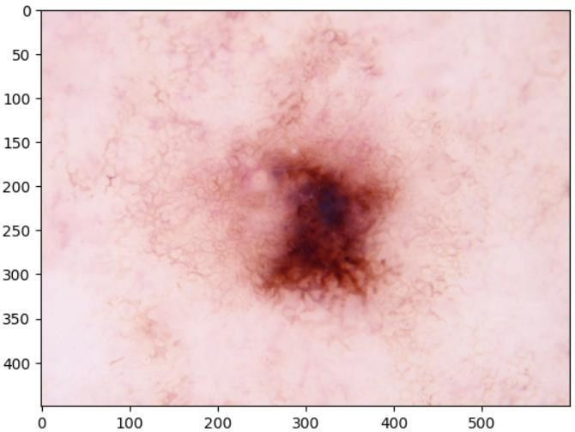
DATASET DESCRIPTION
The Skin Disease Image Dataset is a curated collection of high-resolution images aimed at facilitating research and development in the field of dermatology and healthcare. The purpose of this dataset is to aid in The development and assessment of machine learning models that forecast different skin diseases from visual data.
BA-cellulitis, BA-impetigo, FU-athlete-foot, FU-nail-fungus, FU-ringworm,PA-cutaneous-larva-migrans,VI-shingles ActinicKeratoses,Vascularlesion,BenignKeratosis, Dermatofibroma, Melanoma

Slide 10
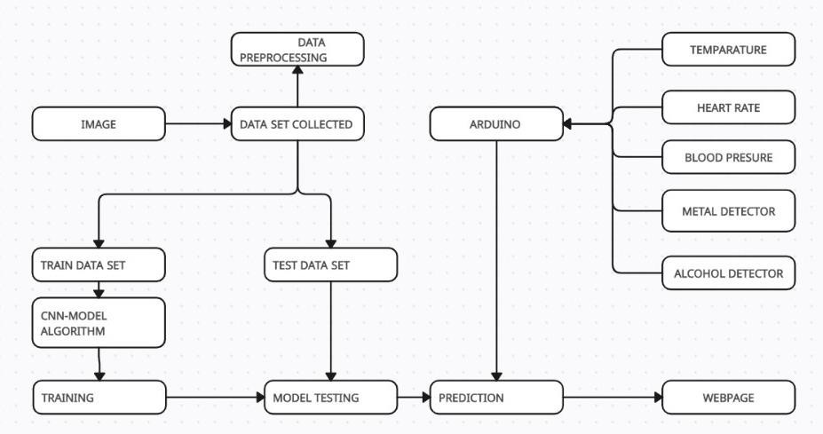
SYSTEM ARCHITECTURE

Slide 11
MODULES DESCRIPTION
SKIN DISEASE AND HEALTH MONITORING SYSTEM
The Health Monitoring and Skin Disease Prediction module is a critical component of the web development project aimed at providing users with comprehensive health tracking capabilities and predictive analysis for skin conditions.The skin disease prediction module integrates several key components to facilitate accurate diagnosis and prediction of skin conditions. Leveraging machine learning algorithms trained on diverse datasets, the module processes input data such as images or symptom descriptions provided by users. Utilizing Flask as the web framework, the module employs user authentication for secure access, data visualization to present predictions comprehensively.The skin disease prediction module offers users a reliable platform for early detection and management of skin conditions, thereby promoting proactive healthcare practices. It integrates various functionalities, including real-time health monitoring, data analysis, and machine learning-based prediction.
REAL-TIME HEALTH MONITORING
Continuous tracking of vital health metrics such as heart rate, blood pressure, temperature, and other relevant parameters.

Slide 12
SKIN DISEASE PREDICTION
Integration of machine learning algorithms to analyze user-provided skin images or symptom descriptions and predict potential skin conditions with associated confidence scores.
DATA VISUALIZATION
Visual representation of health metrics and skin disease prediction results through reports for easy interpretation.
It collects and processes health data from various sources.Utilizes machine learning models trained on skin disease datasets to analyze and predict skin conditions based on user-provided data.Implements algorithms for real-time monitoring of health metrics and detection of anomalies or patterns indicating potential health issues.Integrates with the web application's user authentication and database management systems to ensure secure access and storage of user data.

Slide 13
ALGORITHM
A Convolutional Neural Network (CNN) algorithm operates by leveraging convolutional layers, which apply a set of learnable filters to small regions of the input image, capturing different features like edges, textures, or patterns. These convolutions are followed by non-linear activation functions such as ReLU to introduce non-linearity and enhance the model's capacity to learn complex representations.
Subsequently, pooling layers are employed to reduce the spatial dimensions of the feature maps while preserving relevant information. This hierarchical feature extraction process enables the network to learn progressively abstract features.
The learned features are then flattened and passed through fully connected layers for higher-level reasoning and decision-making, ultimately leading to the classification or detection of objects in the input image.

Slide 14
During training, the network's parameters are iteratively adjusted using optimization algorithms like gradient descent, minimizing a predefined loss function, such as cross-entropy loss, to improve the network's performance in accurately predicting the target labels associated with the input images. This iterative learning process allows CNNs to automatically learn discriminative features from raw input data, making them highly effective in various visual recognition tasks across different domains.
IMAGE RESIZING:
Resized Image=resize(Original Image,(Target Width,Target Height))
NORMALIZATION:
Normalized Pixel Value=Original Pixel Value / Maximum Pixel Value

Slide 15
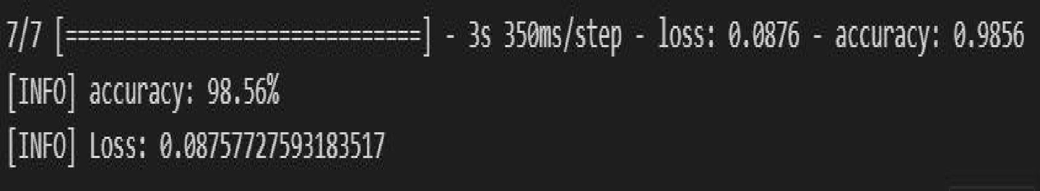
ACCURACY
In machine learning, accuracy refers to how well a trained model performs on a different dataset that it was not exposed to during training. One frequent metric used to evaluate how well the model predicts the target accurately is accuracy.Compare the expected results of the model with the real results (ground truth) obtained from the testing dataset.
Accuracy=Number of Correct Predictions/Total Number of Predictions×100

Slide 16
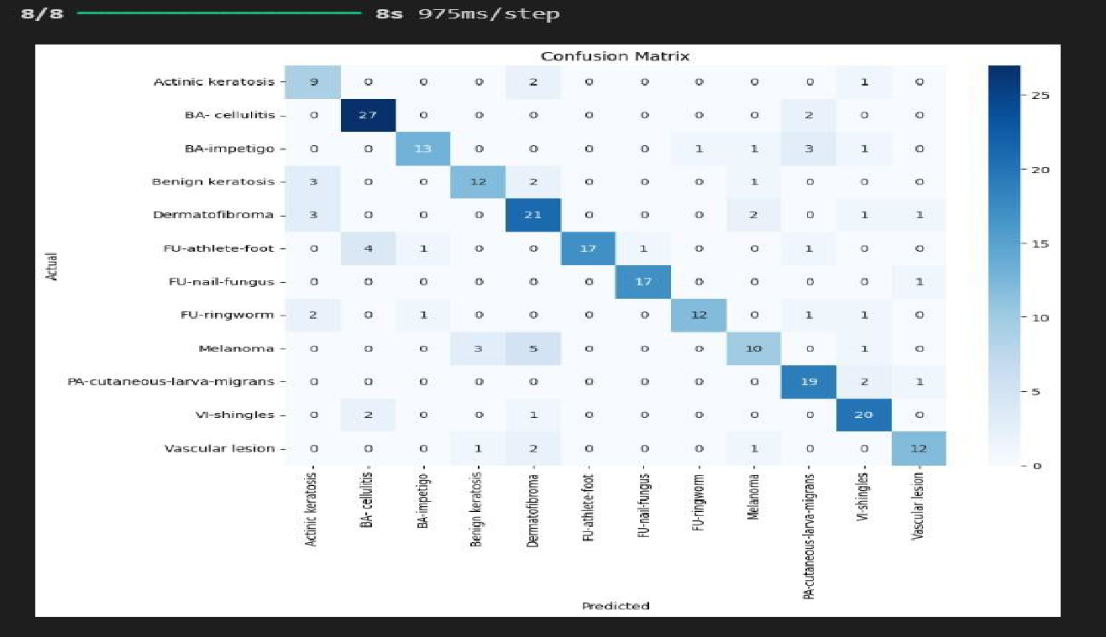
CONFUSION MATRIX
The model is trained and evaluated on subsets of the ground truth and then we evaluate the results looking for specific patterns.confusion matrix to provide more insights into the model's performance. It breaks down correct and incorrect predictions for each class, allowing you to identify false positives, false negatives, true positives, and true negatives.

Slide 17
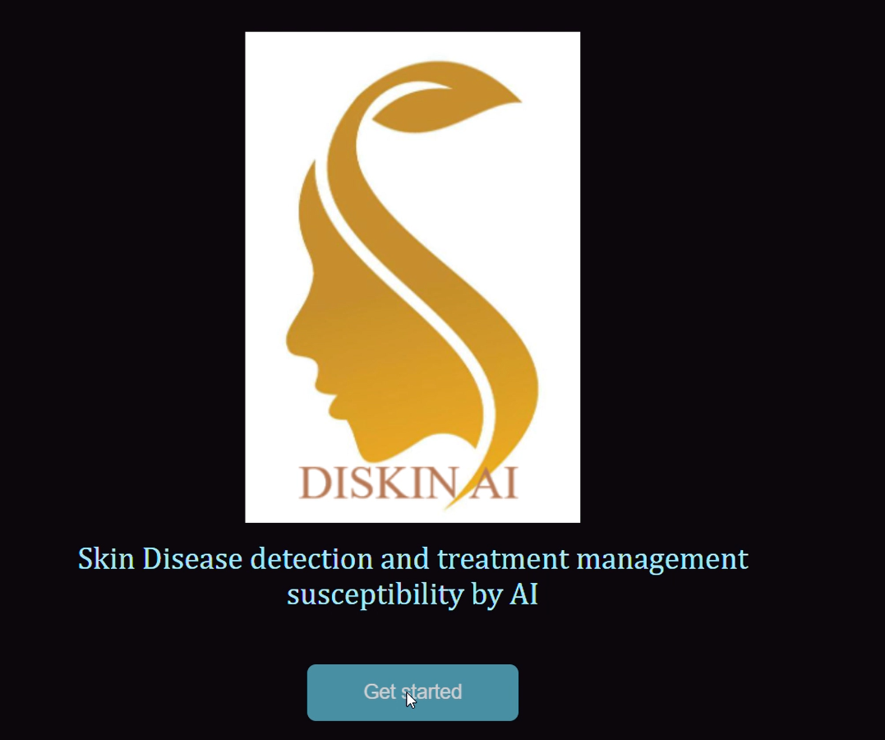
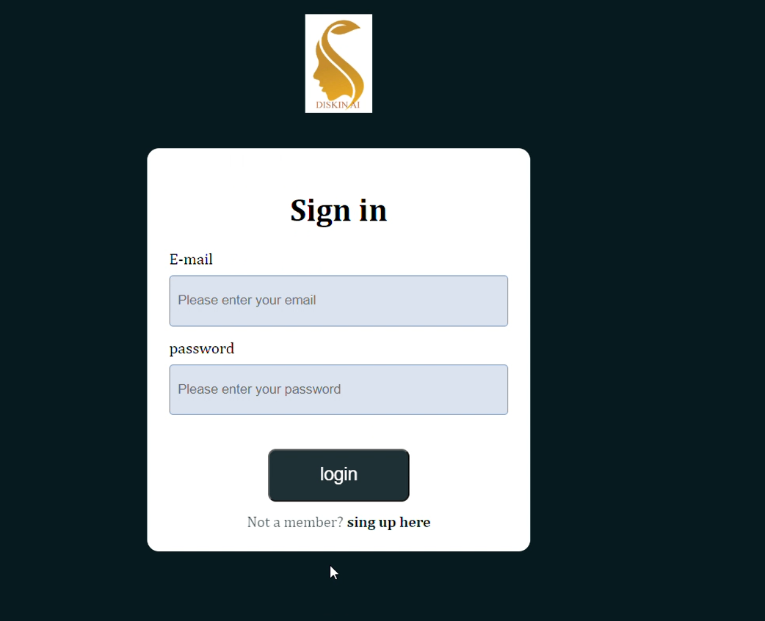
RESULT
SCREENSHOT OF START PAGE
SCREENSHOT OF LOGIN PAGE

Slide 18
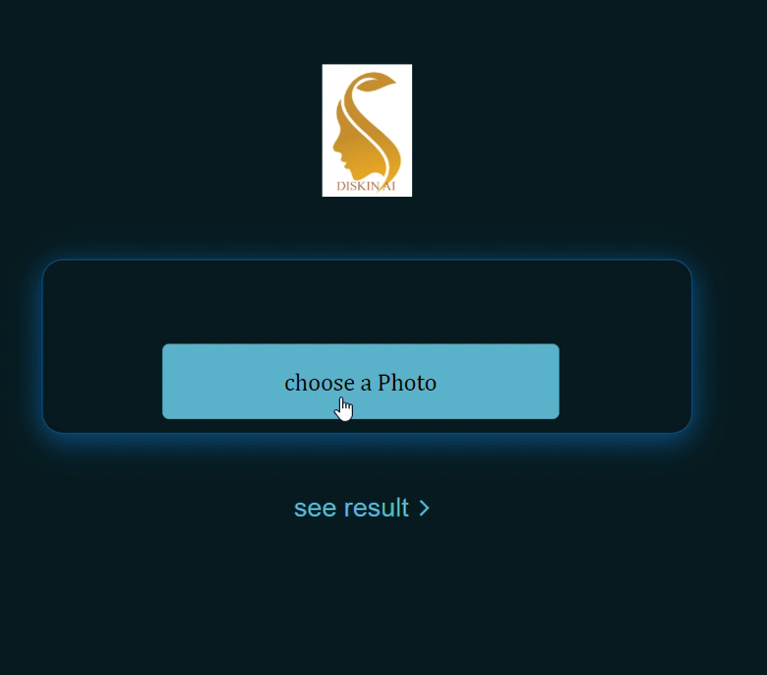
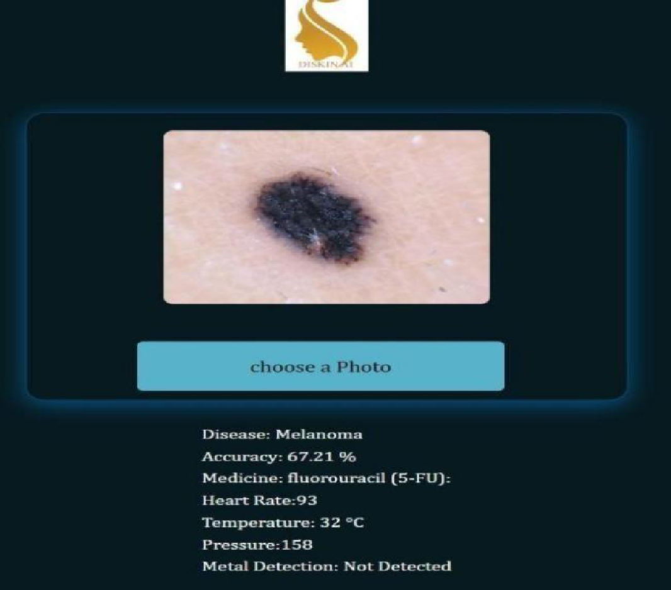
SCREENSHOT OF UPLOADING PAGE
SCREENSHOT OF RESULT PAGE

Slide 19
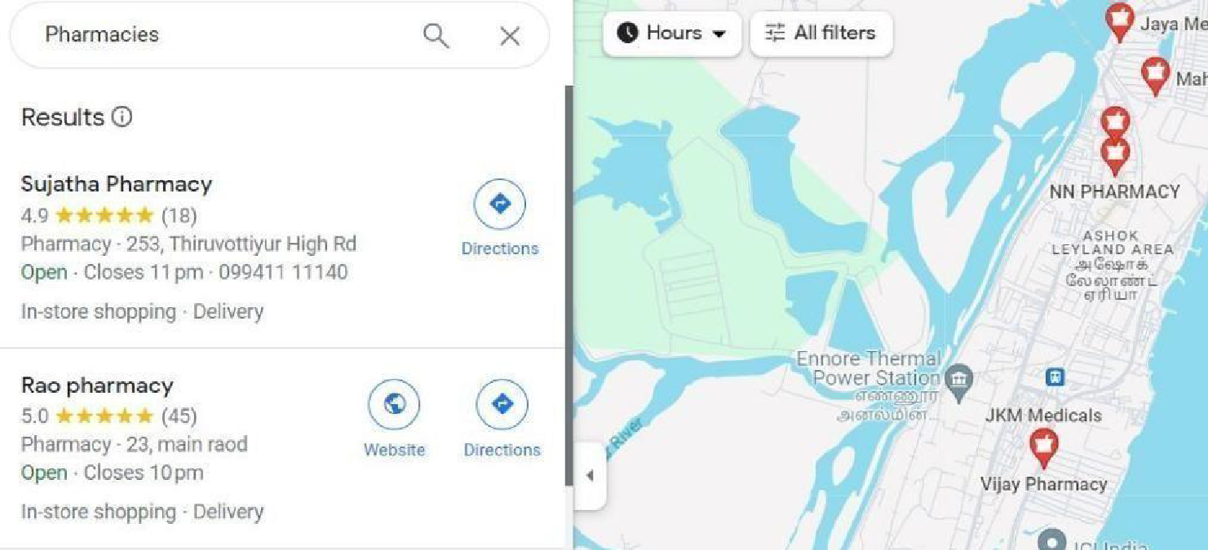
SCREENSHOT OF CLINICS

Slide 20
REFERENCE
1.Steven Hayward , Katherine van Lopik, Andrew West. A holistic approach to health and safety monitoring: Framework and technology perspective.Internet of Things 20 (2022) 100606
2.Jagdis etal., Cruz-Vargas J.A.D.L., Camacho M.E.R. Advance study of skin diseases detection using image processing methods NVEO(2022)
3.Prajoona Valsalan, Tariq Ahmed Barham Baomar, Ali Hussain Omar Baabood “IOT BASED HEALTH MONITORINGSYSTEM”, Research Gate 2020
4.Kefeng Wei, Lincong Zhang , Yi Guo, And Xin Jiang”Health Monitoring Based on Internet of Medical Things: Architecture, Enabling Technologies, and Applications” Feb 13, 2020
5.AlDera S.A., Othman M.T.B.”A model for classification and diagnosis of skin disease using machine learning and image processing techniques” Science Direct (2019)
6.Kushal Pokhrel,Cesar Sanin,Md. Kowsar Hossain Sakib,Md Rafiqul Islam”.Improved Skin Disease Classification with Mask R-CNN and Augmented Dataset” Research Gate(2023)

Slide 21
7. Abderahman Rejeb , Karim Rejeb , Horst Treiblmaier , Andrea Appolloni , Salem Alghamdi , Yaser Alhasawi , Mohammad Iranmanesh "The Internet of Things (IoT) in healthcare”Internet of Things Volume 22, July 2023, 100721
8. Y.A. Qadri, A. Nauman, Y.B. Zikria, A.V. Vasilakos, S.W. Kim”The future of healthcare Internet of Things: a survey of emerging technologies”IEEE Commun. Surv. Tutor., 22 (2020), pp. 1121-1167.
9.R. Lederman, O. Ben-Assuli, T.H. Vo “The role of the Internet of Things in Healthcare in supporting clinicians and patients: a narrative review”Health Policy Technol., 10 (2021).
10.Singh, B., & Kaunert, C. (2024). Integration of Cutting-Edge Technologies such as Internet of Things (IoT) and 5G in Health Monitoring Systems GLS Law Journal , 6(1), 13 - 20.
11.Kinza Shafique, “Internet of things (IoT) for next-generation smart systems: A review of current challenges, future trends and prospects for emerging 5G-IoT scenarios” Ieee Access, 8 (2020).
12.Tanvi Goswami ,Vipul K. Dabhi ,Harshadkumar B. Prajapati”Skin Disease Classification from Image “2020 6th International Conference on Advanced Computing & Communication Systems (ICACCS)

Slide 22
13. N. Gessert, T. Sentker, F. Madesta, R. Schmitz, H. Kniep, I. Baltruschat,5 Werner and A. Schlaefer, “Skin Lesion Classification Using CNNswith Patch-Based Attention and Diagnosis-Guided Loss Weighting,”IEEE Transactions on Biomedical Engineering, 2019
14. T. Shanthi, R.S. Sabeenian, R. Anand, “Automatic Diagnosis of Skin Diseases Using Convolutional Neural Network”, Elsevier, Microprocessors and Microsystems volume 76, July 2020, 103074
15. Viswanatha Reddy Allugunti “A machine learning model for skin disease classification using convolution neural network” International Journal of Computing, Programming and Database Management 2022; 3(1): 141-147.

Slide 23
BASE PAPER LINK
https://ieeexplore.ieee.org/document/9076413

Slide 24
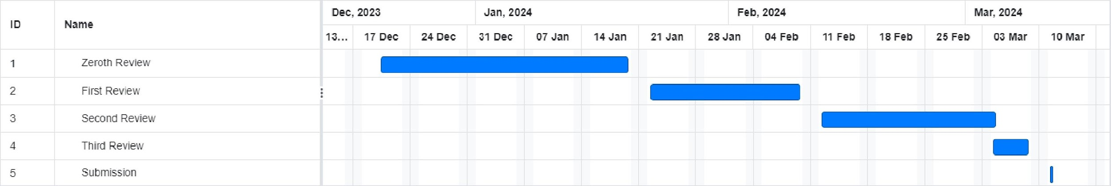
TIME LINE CHART

